Slide 1
Coexpression and Collaborative Gene Networks
Hairong Wei
Michigan Technological University

Slide 2
References
Persson, S., H. Wei, J. Milne, G. Page, C. Somerville. 2005. Identification of genes required for cellulose synthesis by regression analysis of public microarray data sets. Proc Natl Acad Sci USA, 102: 8633-8638. (Faculty 1000 evaluation)
Wei, H, S. Persson, T. Mehta, V. Srinivasasainagendra, L. Chen, G. Page, C. Somerville, A. Loraine. 2006. Transcriptional coordination of the metabolic network in Arabidopsis thaliana. Plant Physiology. 142(2):762-74.
Nie, J., R. Stewart, F. Ruan, J. Thomson, H. Zhang, X. Cui and H. Wei. 2011. TF-Cluster: a pipeline for identifying functionally coordinated transcription factors via network decomposition of the shared coexpression connectivity matrix (SCCM). BMC Systems Biology, 5:53.
Ji, X. S. Chen, J. Li, W. Deng, Z. Wei and H. Wei. 2017. SSGA and MSGA: two seed-growing algorithms for constructing collaborative subnetworks. Scientific Reports. (in press)

Slide 3
What is coexpression network ?
A gene co-expression network (GCN) is an undirected graph, where each node corresponds to a gene, and a pair of nodes is connected with an edge if there is a significant co-expression relationship between them.

Slide 4
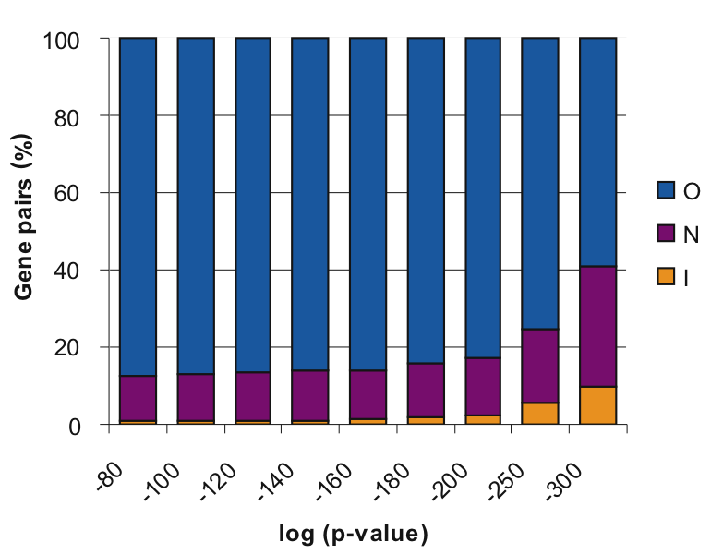
Are Genes involved in the same biological pathway coexpressed?
.
Hypothesis: The genes having functional association, e.g. in the same pathway, are more tightly co-expressed.
216 biological
pathways that
contain 1330
genes in
Arabidopsis
O-outside
N-different pathway
I-same pathway
Increased
tightness of
co-expression
( Wei et al. 2006. Plant Physiol. 142(2): 762–774)

Slide 5
Intersection of Co-Expression (ICE)
not selected
ranked list
(|G|,average p value)
not selected
selected
not selected
selected
GO analysis, homology searches
selected
selected
1. Define co-expression network.
2. Select a group of “bait” genes. (e.g., a pathway, a complex). Green nodes
3. Perform genome-wide co-expression analysis (correlation or regression).
3. Select genes outside the group of baits that are linked with >1 group members G.
4. Sort them by |G|, then average p value (or r²)
( Wei et al. 2006. Plant Physiol. 142(2): 762–774)

Slide 6
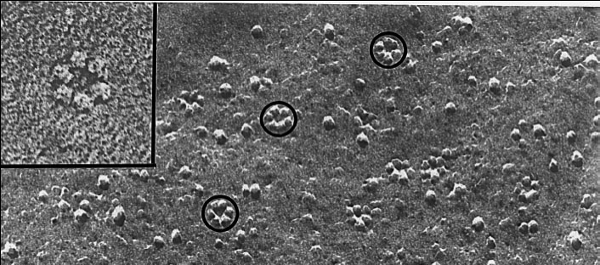
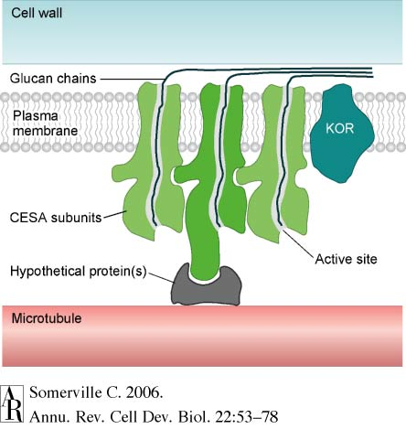
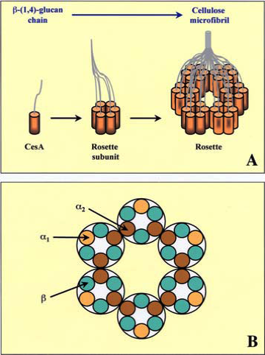
ICE Implementation 1: finding functionally associated genes
A very challenging problem:
What genes in addition to
CEAS genes ( 4, 7 and 8) are required for secondary cell wall synthesis?
Primary: CESA1,3,6 Secondary: CESA4, 7, 8

Slide 7
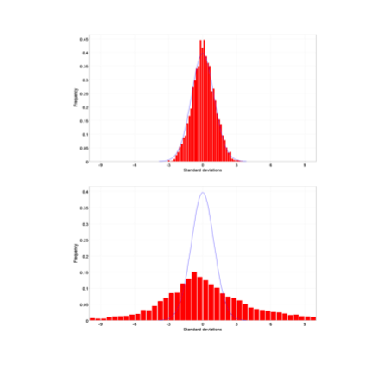


503 Arabidopsis Microarray CEL Files
Normal distribution
Data Sets
Quality Control
3
408 quality dataset
For n genes and m data sets,
deleted residual
obeys t distribution with m-2 df
Subset 1 subset 2 subset 3 subset 4
Regression
ICE of CESA4,7,8
(Persson and Wei et al, 2005, PNAS, Vol102:8633)

Slide 8
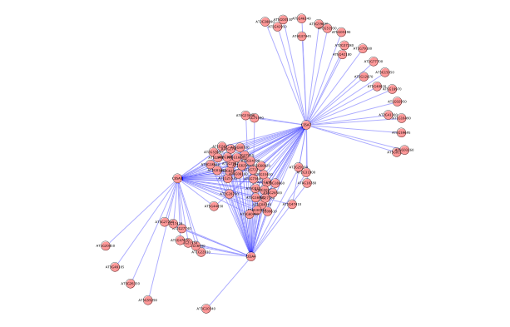
A coexpression network centered
around AtCESA4, 7 and 8
ICE
CESA7
CESA8
Intersection
CESA4

Slide 9
Genes selected from ICE
AGI | Gene title | Score* | P-value
AT5G44030 | cellulose synthase, catalytic subunit (IRX5/CESA4) | 4 | 4.1E-35
AT4G18780 | cellulose synthase, catalytic subunit (IRX1/CESA8) | 5 | 7.1E-33
AT5G54690* | glycosyl transferase family 8 protein | 5 | 4.1E-35
AT5G17420 | cellulose synthase, catalytic subunit (IRX3/CESA7) | 5 | 3.7E-30
AT3G16920* | CTL1-like | 6 | 9.3E-33
AT2G38080 | laccase, putative / diphenol oxidase, putative | 6 | 1.4E-34
AT5G15630 | COBRA cell expansion protein COBL4 | 7 | 1.6E-32
AT5G03170* | fasciclin-like arabinogalactan-protein (FLA11) | 8 | 6.7E-32
AT2G37090 | glycosyl transferase family 43 protein | 10 | 2.3E-29
AT3G18660 | glycogenin glucosyltransferase (glycogenin)-related | 29 | 4.9E-23
AT4G27435* | expressed protein | 30 | 2.6E-24
AT5G60720 | expressed protein | 37 | 1.2E-20
AT3G62020 | germin-like protein (GLP10) | 42 | 9.2E-21
AT5G60020 | laccase, putative / diphenol oxidase, putative | 58 | 1.1E-17
AT4G28500 | no apical meristem (NAM) family protein | 62 | 9.7E-24
AT5G60490 | fasciclin-like arabinogalactan-protein (FLA12) | 64 | 7.9E-21
These genes highlighted in blue are four selected for experiment validation
Notes:
In accordance with their nomenclature, we have named the mutants with xylem deformations irx8 (At5g54690) and irx13 (At5g03170).

Slide 10
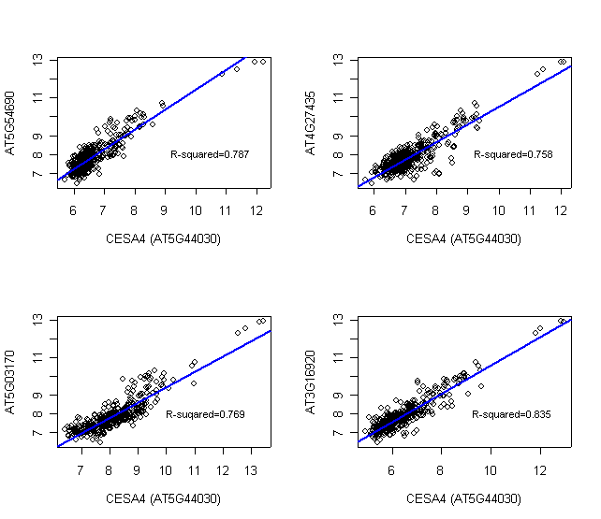

Slide 11
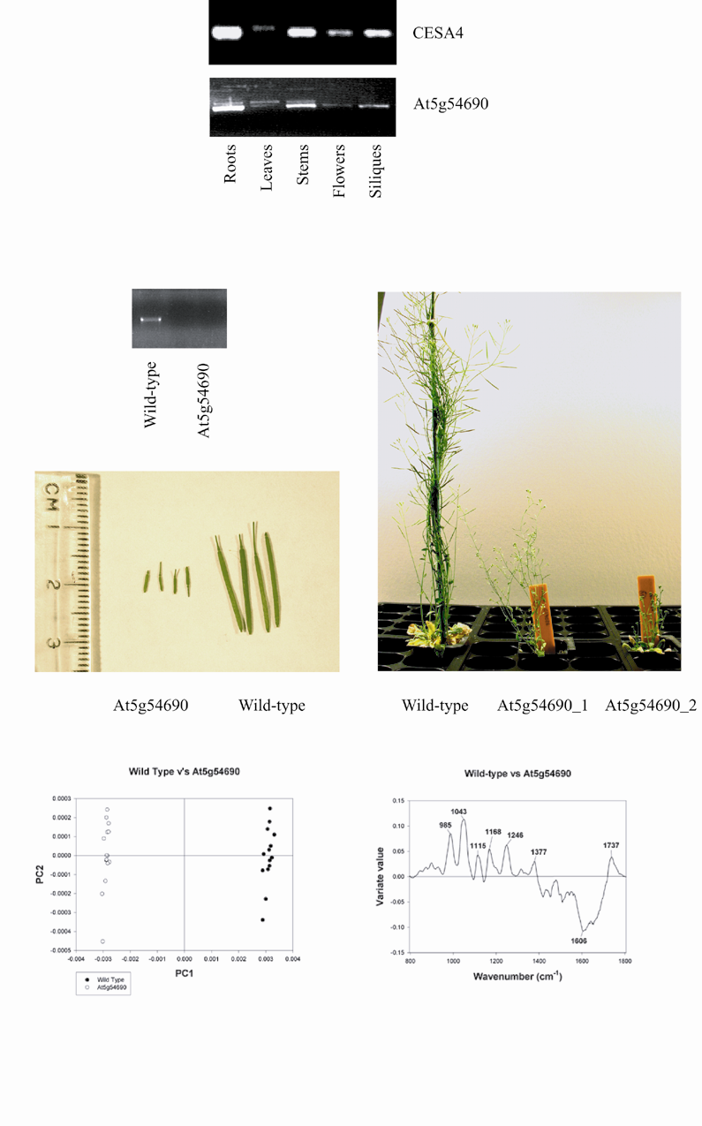
Phenotypic changes in mutant lines
Notes:
Cell wall analyses by FTIR. (A-F) Principal components plots for mutant [irx1, irx8 (SALK_014026), irx13 (SALK_046976), At3g16920 (SALK_055713), and At4g27435 (SALK_137109)] vs. wild-type spectra. Spectra for all mutants show a clear separation from wild-type spectra based on principal component (PC) 1. In all cases, the mutant spectra show differences from wild-type spectra in the carbohydrate fingerprint regions that correspond to the deformations of cellulosic and noncellulosic polymers.

Slide 12
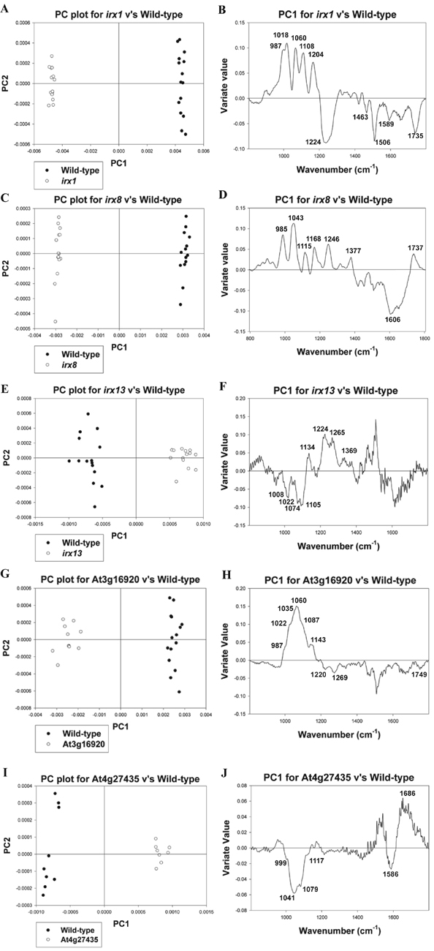
FTIR Analysis
Fourier Transform Infrared Spectroscopy s a technique which is used to obtain an infrared spectrum of absorption or emission of a solid, liquid or gas.
Cell wall analyses by FTIR. (A-F) Principal components plots for mutant [irx1 (CESA4 mutant), irx8 (SALK_014026, At5g54690), irx13 (SALK_046976, At5g03170 ), At3g16920 (SALK_055713), and At4g27435 (SALK_137109)] vs. wild-type spectra.
Spectra for all mutants show a clear separation from wild-type spectra based on principal component (PC) 1. In all cases, the mutant spectra show differences from wild-type spectra in the carbohydrate fingerprint regions that correspond to thedeformations of cellulosic and noncellulosic polymers.

Slide 13
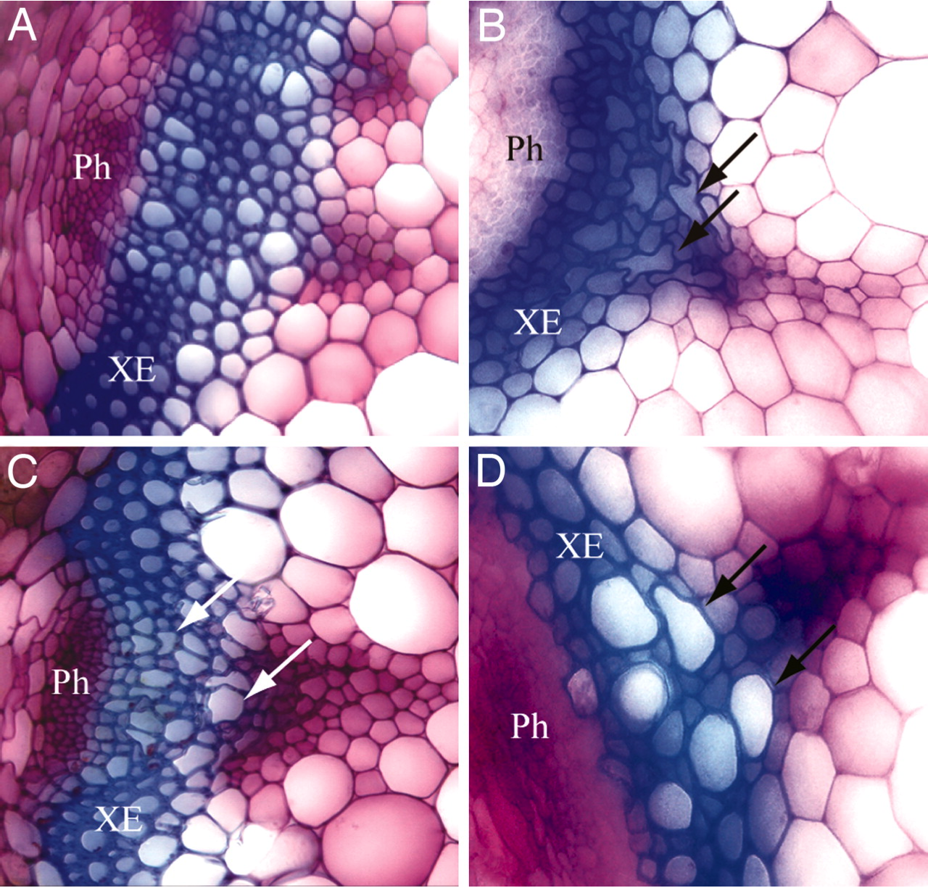
wild type CESA4 mutant (Irx1)
At5g54690 knockout (Irx8) At5g03170 knockout (Irx13)
Notes:
In accordance with their nomenclature, we have named the mutants with xylem deformations irx8 (At5g54690) and irx13 (At5g03170).

Slide 14
Related studies
Among the 25 genes, 16 are the same as those genes identified by Dr. Simon Turner via forward genetics
Brown DM, Zeef LA, Ellis J, Goodacre R, Turner SR (2005) Identification of novel genes in Arabidopsis involved in secondary cell wall formation using expression profiling and reverse genetics. The Plant cell 17(8): 2281-95.
2. Irx8 (At5g54690) protein has been shown to target to Golgi, where glucuronoxylans (GXs) are synthesized. Irx8 is implicated in affecting GX synthesis. GX, cellulose, and lignin are three major components of secondary cell walls in woody plants.
Pena et al, Arabidopsis irregular xylem8 and irregular xylem9: Implications for the Complexity of Glucuronoxylan Biosynthesis The Plant Cell 19:549-563 (2007)

Slide 15
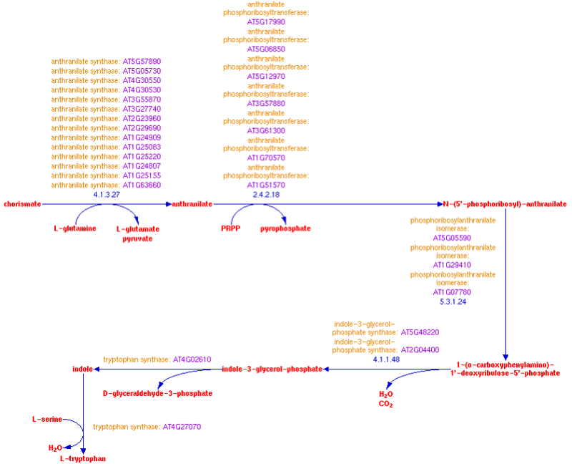
ICE: potential use for predicting
pathway genes
ICE results for: Tryptophan Biosynthesis, a connection
with camalexin biosynthesis
AT3G26830
camalexin biosynth.
AT2G38860
unknown
AT3G461100
unknown
Biosynthesis of Camalexin from Tryptophan Pathway Intermediates in Cell-Suspension Cultures of Arabidopsis
Plant Physiol. 1998, 118(4): 1389–1393
Notes:
Camalexin (3-thiazol-2′-yl-indole) is the principal phytoalexin that accumulates in Arabidopsis after infection by fungi or bacteria. Camalexin accumulation was detectable in Arabidopsis cell-suspension cultures 3 to 5 h after inoculation with Cochliobolus carbonum (Race 1), and then increased rapidly from 7 to 24 h after inoculation. Levels of radioactivity incorporated into camalexin during a 1.5-h pulse labeling with [14C]anthranilate also increased with time after fungal inoculation. The levels of radioactive incorporation into camalexin increased rapidly between 7 and 18 h after inoculation, and then decreased along with camalexin accumulation. Relatively low levels of radioactivity from [14C]anthranilate incorporated into camalexin in the noninoculated controls. Autoradiographic analysis of the accumulation of chloroform-extractable metabolites labeled with [14C]anthranilate revealed a transient increase in the incorporation of radioactivity into indole in fungus-inoculated Arabidopsis cell cultures. The time-course measurement of radioactive incorporation into camalexin during a 1.5-h pulse labeling with [14C]indole was similar to that with [14C]anthranilate. These data suggest that indole destined for camalexin synthesis is produced by a separate enzymatic reaction that does not involve tryptophan synthase.
Top
Abstract
MATERIALS AND METHODS
RESULTS
DISCUSSION
LITERATURE CITED
One of the most intensively studied disease-resistance mechanisms of plants is the accumulation of phytoalexins. Apart from this function, there is interest in phytoalexins because the induction of synthesis of these secondary metabolites provides unique experimental systems for the study of the coordinate regulation of primary and secondary metabolic pathways. One system that likely involves the coordinate regulation of these pathways is the biosynthesis of phytoalexins in Arabidopsis.
Arabidopsis has several attributes that are ideal for the genetic analysis of disease-resistance mechanisms (Meyerowitz, 1989; Kunkel, 1996). It accumulates the phytoalexin camalexin (3-thiazol-2′-yl-indole) (Tsuji et al., 1992), a compound originally isolated from another crucifer, Camelina sativa (Browne et al., 1991). This metabolite is typical of crucifer phytoalexins in having an indole group substituted at the no. 3 position with a sulfur-containing group (Chapple et al., 1994). In in vitro bioassays, camalexin is inhibitory to bacterial and fungal growth (Jejelowo et al., 1991; Tsuji et al., 1992; Rogers et al., 1996). Mutants of Arabidopsis deficient in camalexin accumulation have been isolated (Glazebrook and Ausubel, 1994). These pad mutants have not yet provided clear evidence for the role of camalexin in the disease resistance of Arabidopsis, but a recently isolated pad4 mutant exhibits an interesting phenotype that may provide insight into differential host plant responses between pathogens and nonpathogens (Glazebrook et al., 1997).
Advances have been made in recent years in the study of Trp synthesis in Arabidopsis (Radwanski and Last, 1995). The study of individual steps in the Trp pathway is important to understand the coordinate regulation of the Trp and camalexin pathways during the induction of camalexin synthesis. Labeling studies have provided evidence that anthranilate, a Trp-pathway intermediate, but not Trp itself, is a precursor of camalexin (Tsuji et al., 1993; Zook and Hammerschmidt, 1997). Furthermore, there is a close correlation between the level of induction of anthranilate synthase and camalexin accumulation in response to different eliciting agents (Zhao and Last, 1996). However, there remains uncertainty about what Trp intermediate is the branch point between the Trp and camalexin biosynthetic pathways. In the current study suspension cultures of Arabidopsis cells inoculated with fungal spores were used to characterize the biosynthetic relationship between Trp-pathway intermediates and the accumulation of the camalexin phytoalexin.

Slide 16
Summary for coexpression network:
Co-expression network can be used to predict genes involved in various pathways and biological processes. It is especially suitable for predicting functionally associated genes, metabolic pathway genes, structural genes that are usually located at the low hierarchical terminals of gene regulatory networks. These genes are often co-regulated, which is why they are often highly correlated.
Due to the large number of terminal genes, the identification of true genes is often interfered by noise. The prediction of pathway genes in many cases is not accurate. However, it indeed works in some cases.

Slide 17
What is gene collaborative network ?
A gene collaboration network (GCN) is an undirected graph, where each node corresponds to a regulatory gene (e.g. TF), and a pair of nodes is connected with an edge if there is a significant collaboration relationship between them.

Slide 18
Microarray or RNA-seq data
Hypothesis: Regulatory genes (e.g. TFs) controlling a biological process or complex trait are collaborative.

Slide 19
Identification of Regulatory Genes That Collectively Govern Complex Trait?
NETWORK DECOMPOSITION
TFs control a trait or a biological process

Slide 20
How can we identify regulatory genes that are collaborative?
Hypothesis
Regulatory genes that collaboratively control the same complex trait are coordinated in gene expression profiles.
Coexpressed genes refer to those that have higher concordance in expression profiles, whereas coordinated genes refer to those that have relatively looser concordance in expression profiles.
.
Coexpressed genes Collaborative genes

Slide 21
Genome-wide coexpression analysis
TF₁ TF₂ TF₃ ………….…………… TF_{i}………………………………………TF_{n}
G₁
G₂
G₃
G₄
G₅
G₆
…
…
…
…
…
…
…
…
G_{m}
G₅
G₂
G₅₀
G₄
G₅₃₀
G₆₁
…
…
…
…
…
…
…
…
G_{m-10}
1. Spearman
2. Weighted Rank
3. Kendall
4. Hoeffding
5. Distance Cov
6. Theil-sen
7. Pearson
8. Rank Theil-sen
r = 0.95
r = 0.68
P < 10⁻⁵
r>0.89
PLos One
(Kumari et al, 2012)
Where m > 20,000 while n = 1600 ~ 5000
Descending
Association
strength
Functionally coordinated genes Others

Slide 22
Genome-wide coexpression analysis
GOI
TF₁ TF₂ TF₃ ………….…………… TF_{i}………………………………………TF_{n}
G₁
G₂
G₃
G₄
G₅
G₆
…
…
…
…
…
…
…
…
G_{m}
G₅
G₂
G₅₀
G₄
G₅₃₀
G₆₁
…
…
…
…
…
…
…
…
G_{m-10}
Top k
Where k =
50, 100 or 150
Descending
Association
strength
Functionally coordinated genes Others

Slide 23
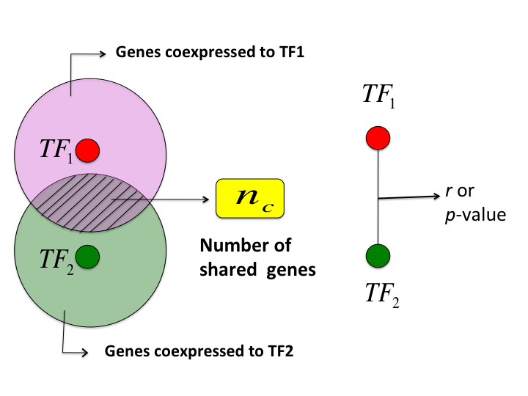

How to measure the loosely coordination between two TFs?
100 genes that are
most tightly coexpressed to TF₁
TF_{i}
TF_{i}
n_{c}
Number of
shared genes
TF_{j}
TF_{j}
100 genes that are
most tightly coexpressed to TF_{j}
Kumari S, Nie J, Chen H-S, Ma H, et al. (2012) Evaluation of Gene Association Methods for Coexpression Network Construction and Biological Knowledge Discovery. PLoS ONE 7(11): e50411. doi:10.1371/journal.pone.0050411
http://www.plosone.org/article/info:doi/10.1371/journal.pone.0050411

Slide 24
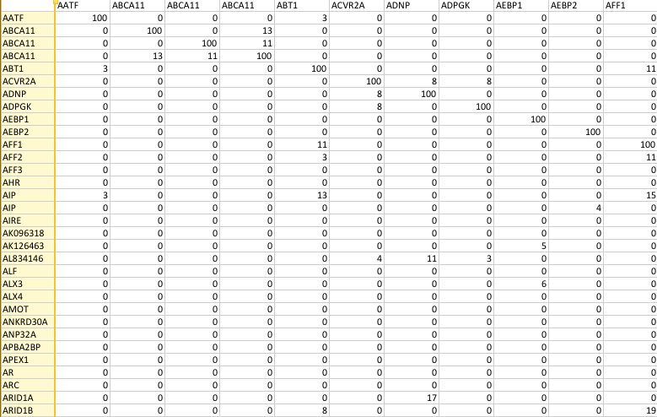
Shared Coexpression Connectivity Matrix (SCCM)
TFs
TFs

Slide 25
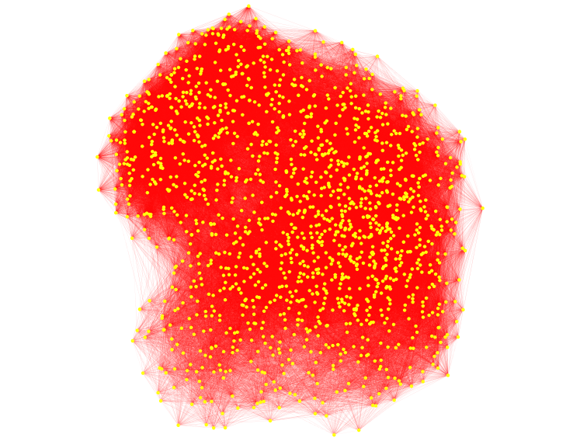
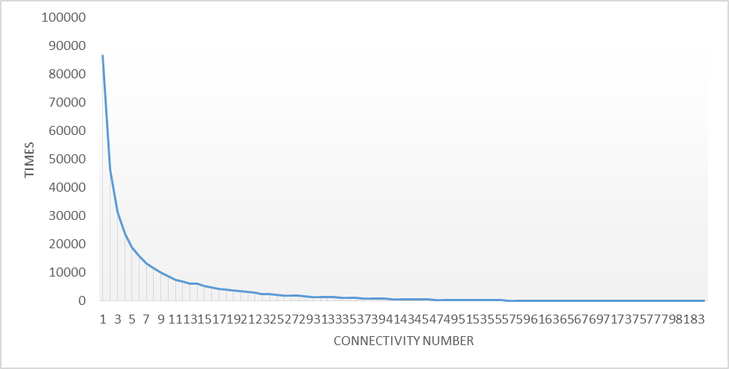
Collaborative Network of TF
shared coexpression connectivity matrix (SCCM)
Collaborative network of all TFs

Slide 26
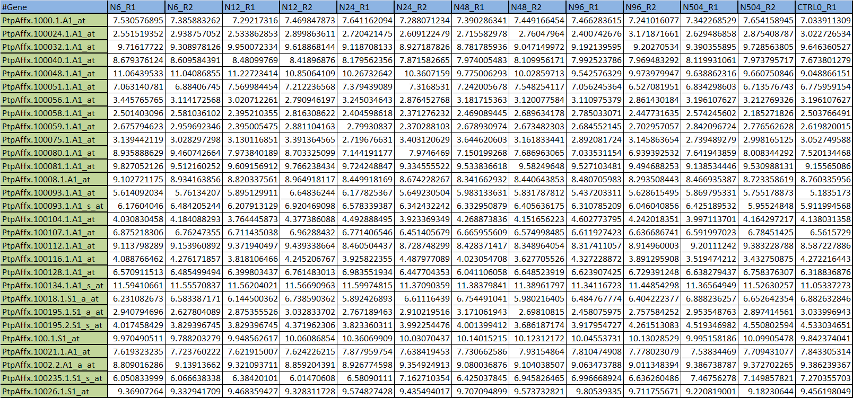
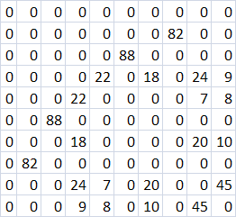
Original Gene Expression Data
Collaborative Network
TF1 2 3 4 5 6 7 8 9 10 …
TF
1
2
3
4
5
6
7
8
9
10
…
How to decompose this collaborative network into subnetworks, each of which controls a biological process or complex trait?

Slide 27
TF
1
2
3
4
5
6
7
8
9
10
…
TF1 2 3 4 5 6 7 8 9 10 …
α=μ+δ
β=μ+2δ
γ=μ+3δ
μ: mean
δ : standard deviation
88
88
TF3 TF6
TF3 TF6
. . . . .
80
78
Triple-Link algorithm
TF100
Single-Seed Growing Algorithm
Multi-Seed Growing Algorithm
Nie et al BMC Systems Biology
Ji et al. Scientific Reports (2017)

Slide 28
Triple-link algorithm
TF
1
2
3
4
5
6
7
8
9
10
…
TF1 2 3 4 5 6 7 8 9 10 …
88
TF3 TF6
α=μ+δ
β=μ+2δ
γ=μ+3δ
88
88
TF3 TF6
TF3 TF6
55
L1 > α
65
55
65
TF1266
L2 > β
L1 > α
TF88
L2 > β
TF1266
L3 > γ
Nie et al. 2011. BMC Systems Biology, 5:53

Slide 29
Test 1: Arabidopsis Data
Arabidopsis salt stress experiments
6 Microarray experiments of Arabidopsis
108 chips (downloaded from GEO)
Question: What TFs control root growth under salt
stress condition in Arabidopsis?

Slide 30
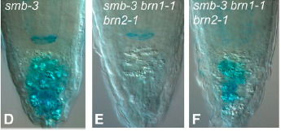
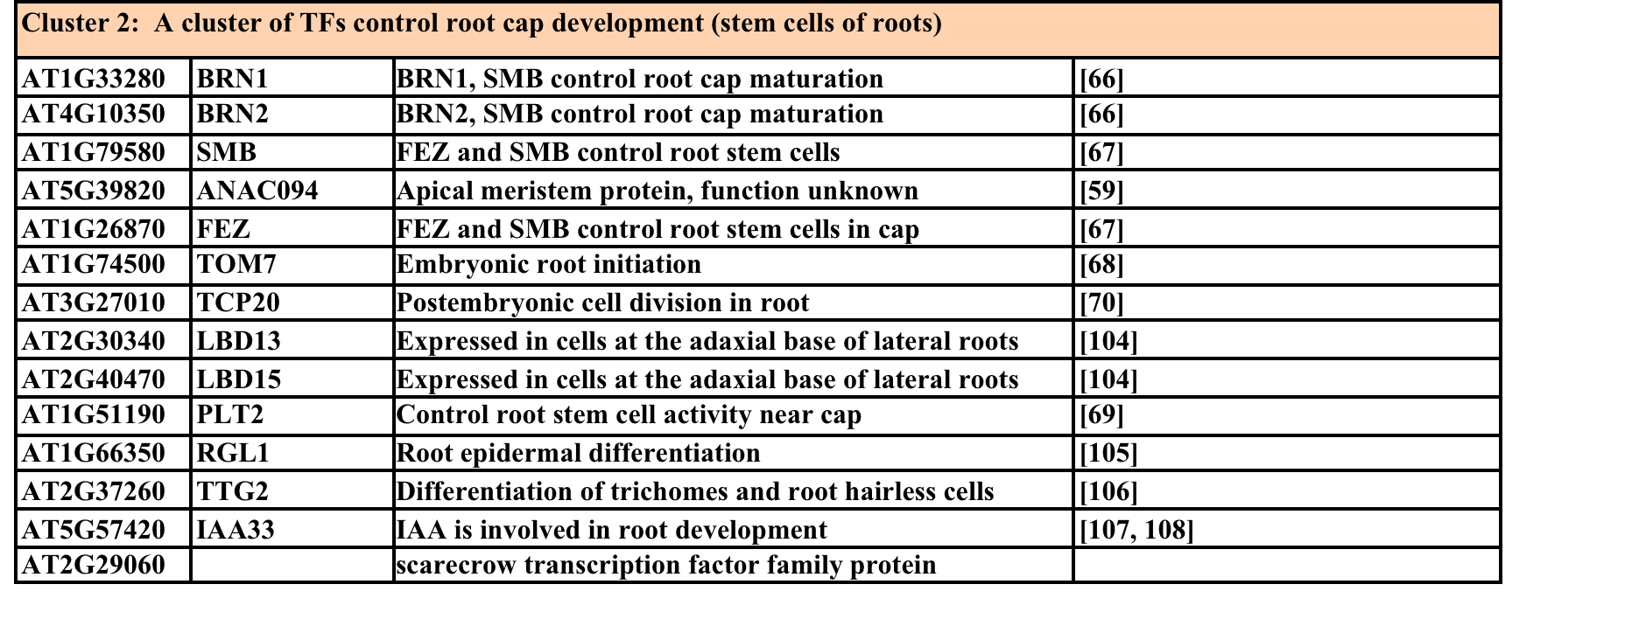
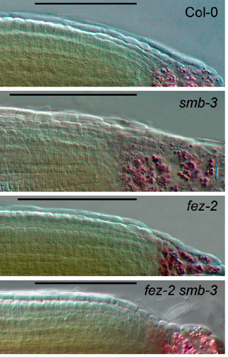
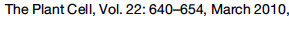
Nie et al: TF-Cluster (BMC Systems Biology, 2011)
BRN1
BRN2
SMB
FEZ

Slide 31
Test 2: Data Set from humans
What TFs are necessary for pluripotency maintenance in human stem cells?
Present knowledge about regulation of human stem cell pluripotency
NANOG + POU5F1 + SOX2
Identified by many
biologists from 1998
to 2008
SALL2 CSRP1 LIN28
PHC1 NANOGP8 MYCL1
PRDM14 LOC653441 DNMT3B
DNMT3A SOX3 RORB
The Power of TFs: Reprogramming in somatic cells
NANOG
POU5F1
SOX2
+ MYC2
Induced Pluripotency Cell (IPC)
Skin Cell

Slide 32
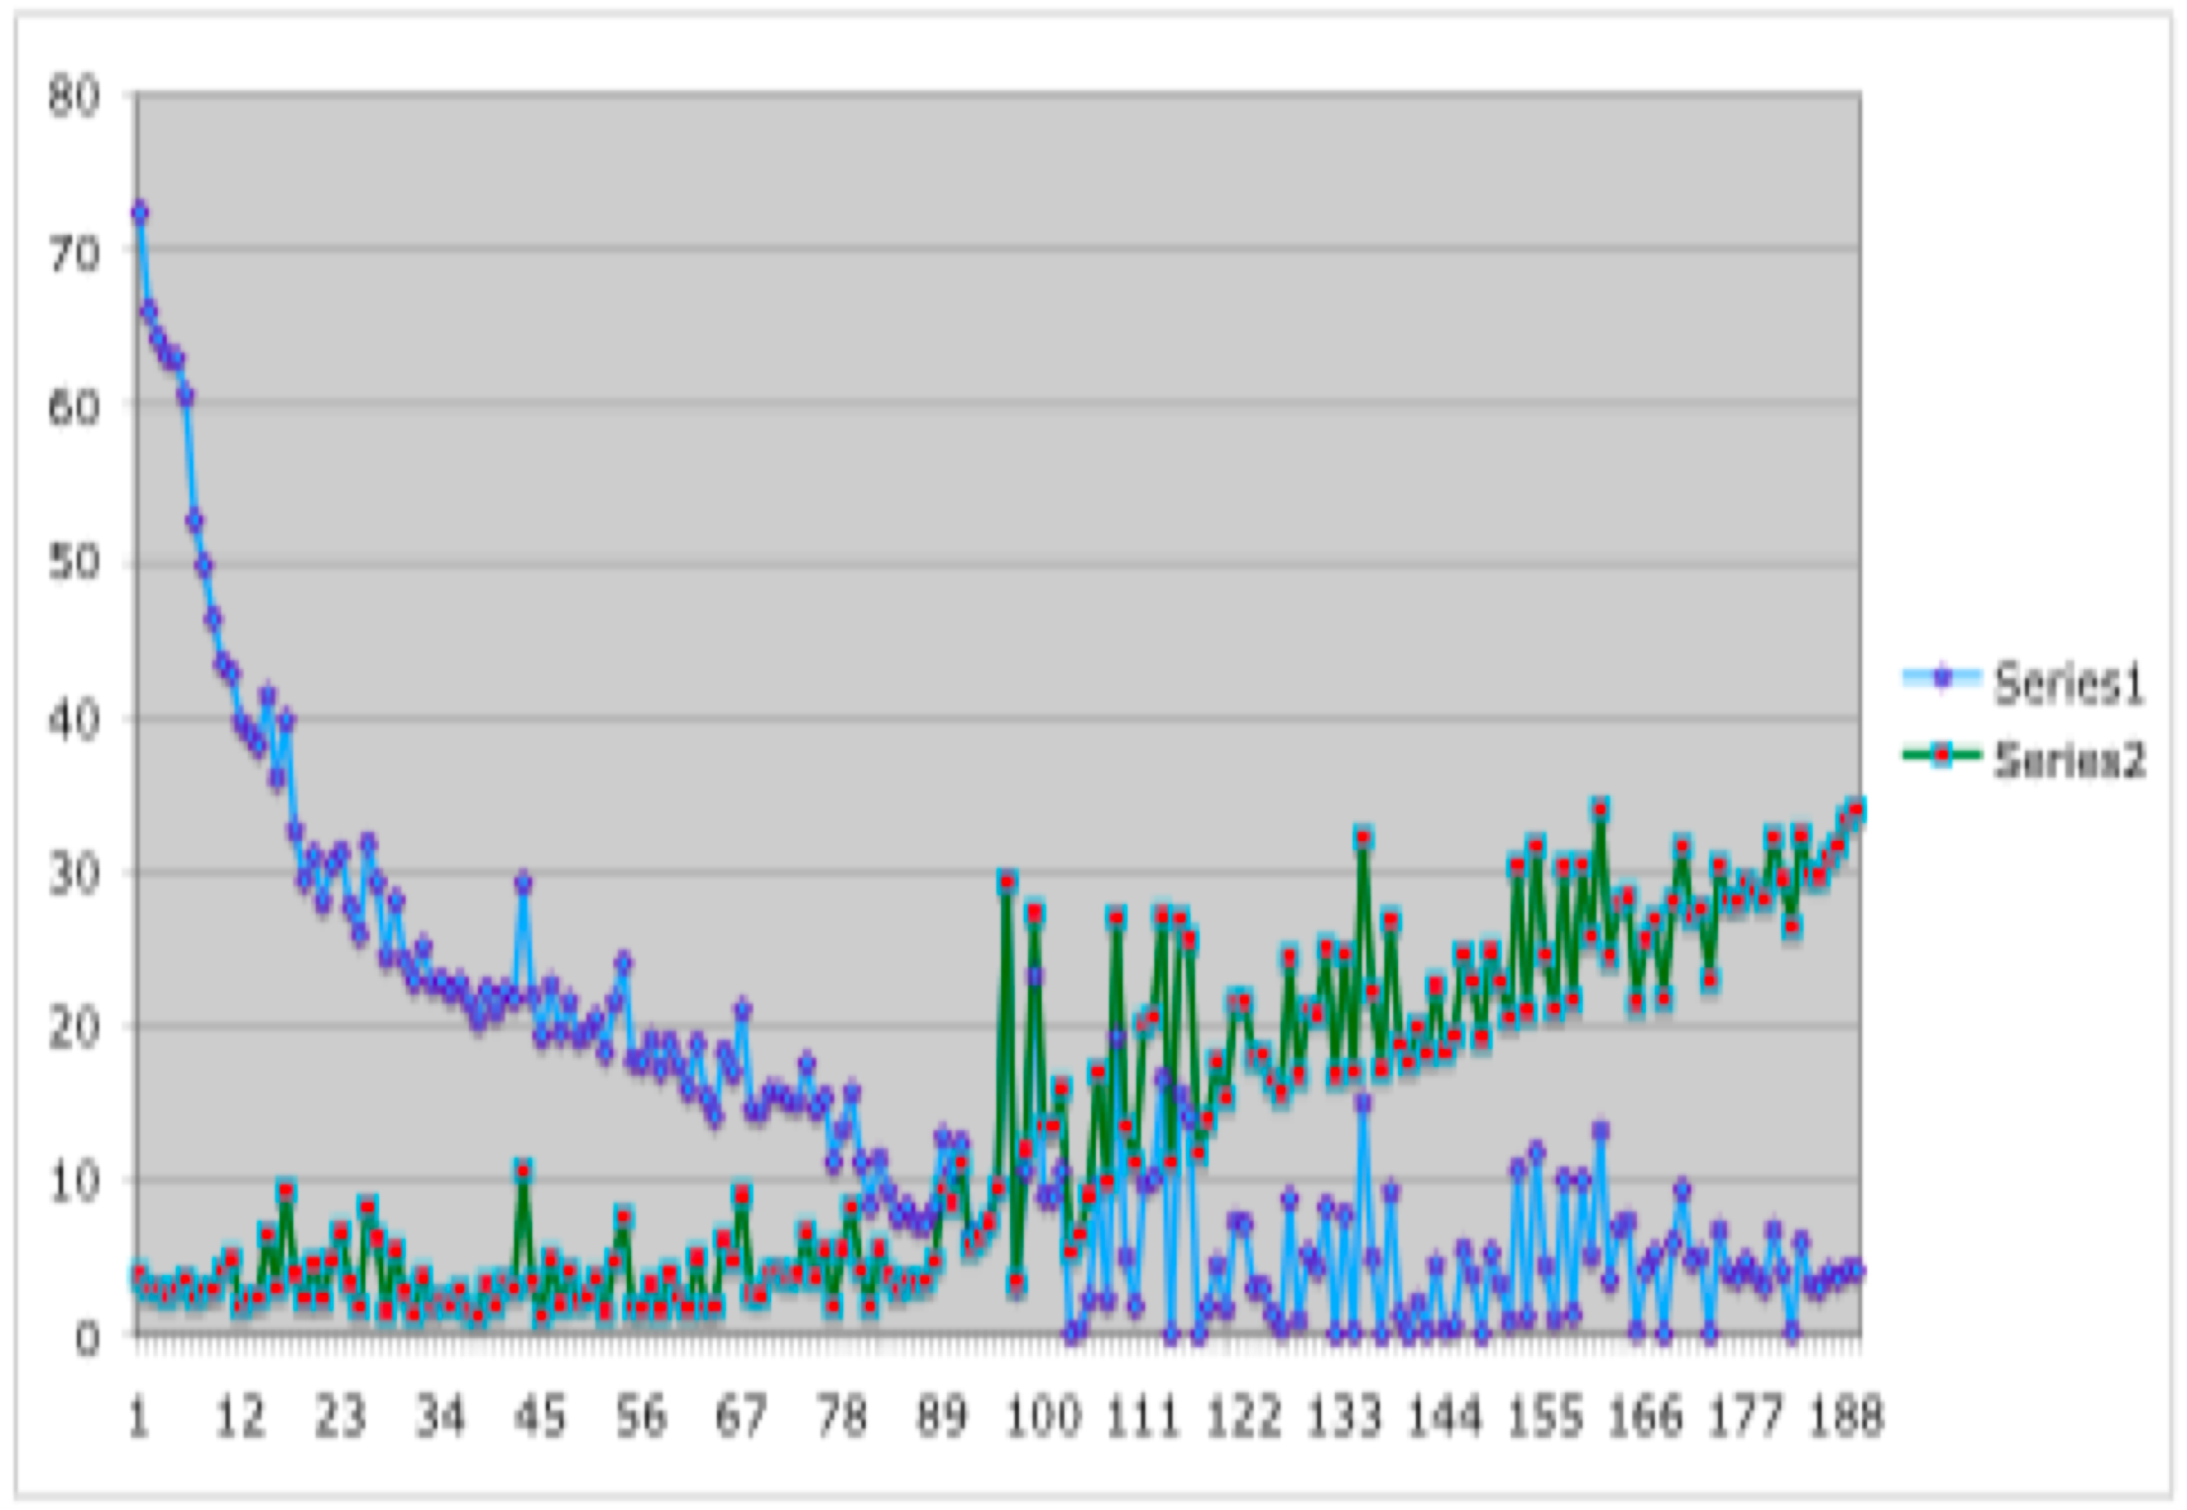
Input data: 189 microarray chips from human stem cells that underwent differentiation from 0 ~ 96 hours.
Differentiation markers
Stem cell markers
Microarray chips (189) provided by James Thomson @ U of Wisconsin

Slide 33
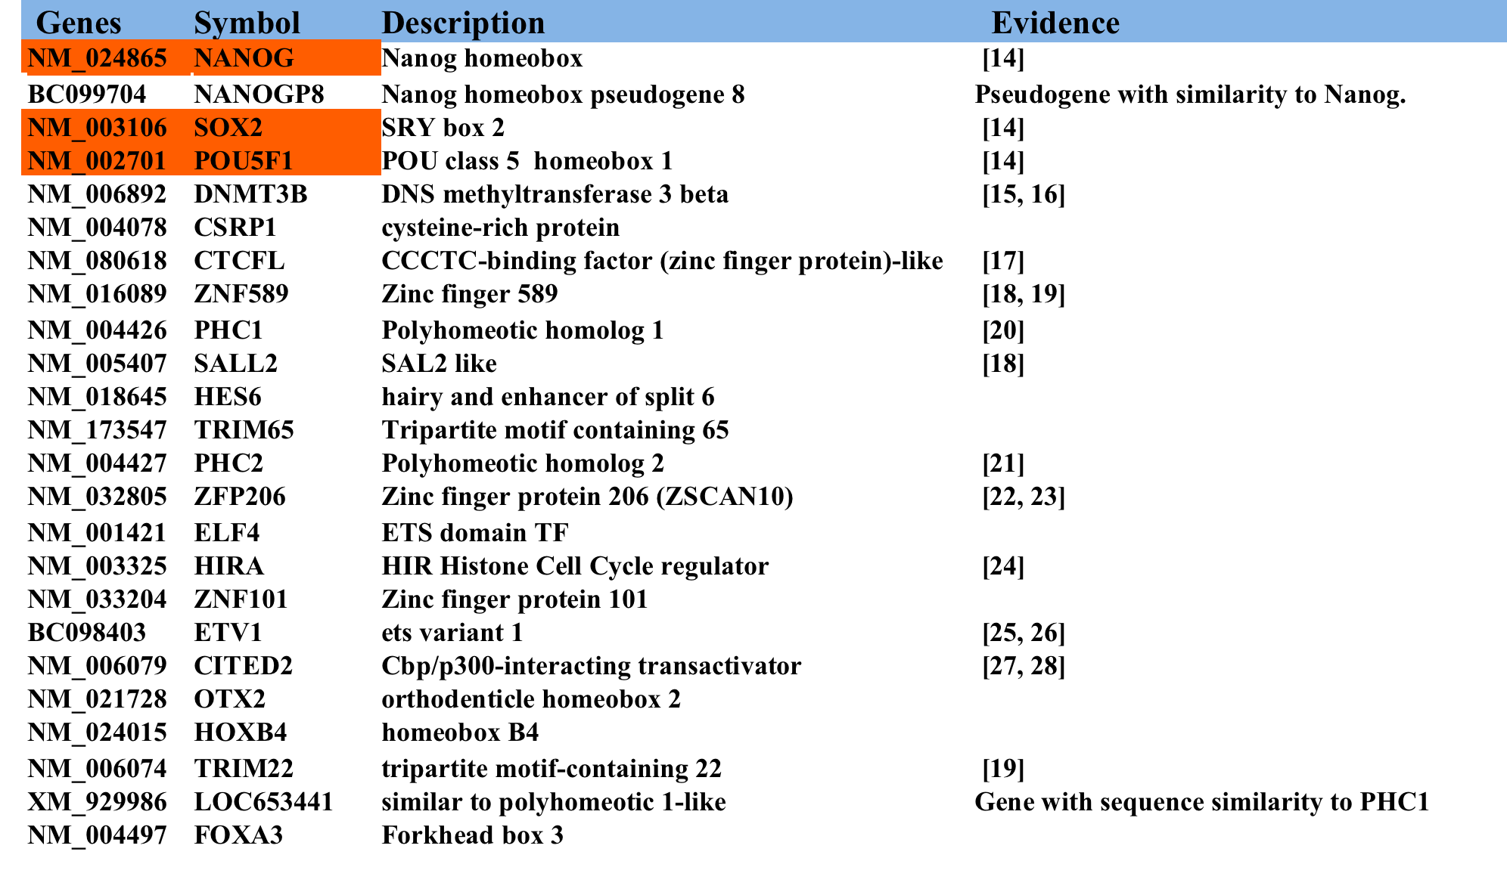
Subnetwork 1 : Output from TF-cluster
Among 24 predicted TFs, 17 have literature evidence(~70%)

Slide 34
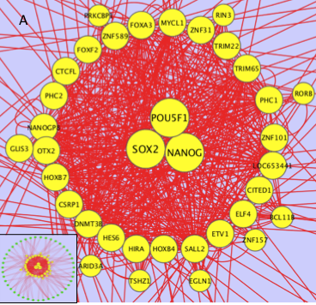
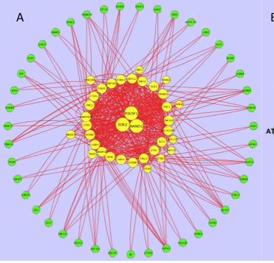
The coordination between TFs within Subnetwork 1
A
B
A. Intra-connections among the genes within Collaborative Subnetwork 1
B. Comparison of intra-subnetwork connections with outward-connections

Slide 35
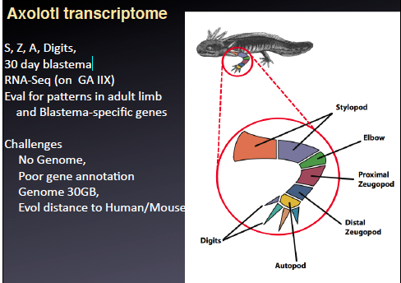
Test 3: Axolotl RNA-Seq
Total 74 samples

Slide 36
Cluster 2: Limb development
1. HES4: multicellular organismal development
2. HOXB1: anterior/posterior pattern formation
3. BARHL2: neuron differentiation
4. CDX2: caudal type homeobox 2
5. CIC
6. FOXH1 nodal expression; Lower-limb Deep Vein Thrombosis
7. FOXJ1: motile cilia, lupus erythematosus
8. FOXN1: skin, nail development
9. GLIS3: limb mesenchymal patterns
10. HES6: limb buds
11. HESX1: multicellular organismal development
12. HNF4A: limb mesoderm
13. HOXA5: skeletal and organ morphogenesis
14. HOXB6: Development
15. OLIG1: oligodendroglial differentiation
16. PAX2:
17. PLAGL1
18. PPARGC1B: stimulate several nuclear receptors
19. RIN3
20. SCML4
21. T: anterior/posterior pattern formation
tail morphogenesis notochord development
22. TAF6L
23. TAL2
24. TGIF2
25. TRAF4: development of the axial skeleton,
the closure of the neural tube
26. ZBTB16
27. ZBTB4
28. ZFPM2: hematopoiesis and cardiogenesis
29. ZNF154
30. ZNF30

Slide 37
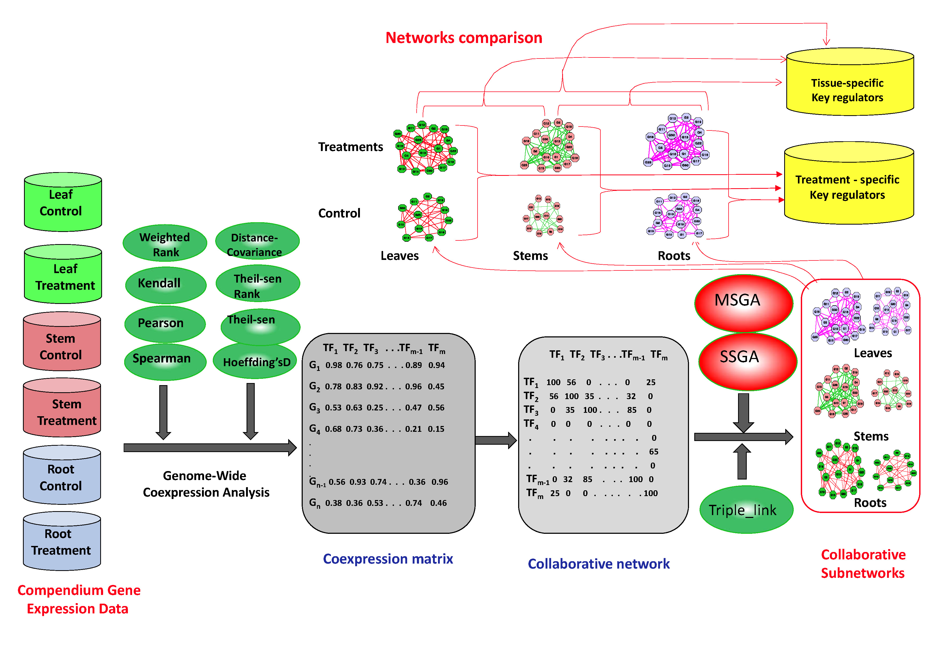
Collaborative Network Pipeline
High-throughput Gene Expression Data
Ji et al. Scientific Reports (2017)

Slide 38
Summary for Collaborative Gene Network:
Construction of collaborative subnetworks of TFs is novel approach for identifying collaborative TFs that govern the same biological process or complex trait using gene expression data. Compared to markers-assistant approaches for identifying genes that control a trait, collaborative subnetwork construction is a more direct one. It appears to be highly efficient because it is based on the footprints of regulatory events in gene expression profiles rather than the information encoded in DNA sequences, for instance, genome-wide gene association by SNPs.
As gene expression data explode, we believe construction of collaborative network will find its way into a wide range of applications for novel biological knowledge discovery.

